Slide 1
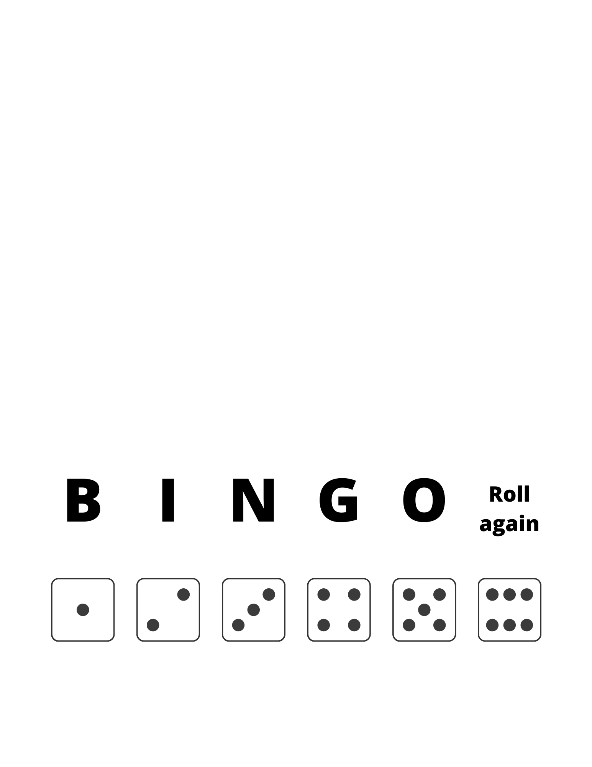
BINGO with BLENDS
B | I | N | G | O
club | flat | glob | lamp | blip
hand | brag | drip | slam | plug
gasp | smog |  | left | scam
craft | soft | swig | gild | last
snap | meld | hunt | help | clog
New Day Literacy 2022

Slide 2
Bl
BINGO with BEGINNING BLENDS (b- blends)
B | I | N | G | O
blob | brat | brand | brig | blab
brag | brad | blimp | blush | bran
blend | blast |  | blunt | blog
brim | bran | blond | brash | bred
bled | blip | brush | bland | blot
New Day Literacy 2022

Slide 3
Bl
BINGO with BEGINNING BLENDS (d-, f-, and g- blends)
B | I | N | G | O
drab | dram | flab | drip | drag
glob | fresh | drop | drum | glib
glop | glum |  | glut | flux
flush | drug | flesh | flex | glad
glug | drift | draft | flit | glen
New Day Literacy 2022

Slide 4
Bl
BINGO with BEGINNING BLENDS (c- blends)
B | I | N | G | O
clam | clap | crust | crop | clash
crab | crag | crush | crib | clip
clog | craft |  | club | clot
crest | clod | clan | clad | crisp
cloth | crimp | cramp | crept | clamp
New Day Literacy 2022

Slide 5
Bl
BINGO with BEGINNING BLENDS (f- blends)
B | I | N | G | O
fret | flab | froth | flux | frog
fresh | flag | flap | flush | flat
Fred | flub |  | flog | flash
flop | flip | fled | flog | flit
flam | flax | flinch | flint | flex
New Day Literacy 2022

Slide 6
Bl
BINGO with BEGINNING BLENDS (s- blends)
B | I | N | G | O
scab | sled | slid | slam | scan
scrub | snug | slim | slop | scat
shrub | snap |  | slap | scrap
slash | smash | smog | snag | snob
scam | smith | slip | smug | slab
New Day Literacy 2022

Slide 7
Bl
BINGO with BEGINNING BLENDS (more s- blends)
B | I | N | G | O
span | swim | spin | stun | spot
splint | sped | strum | spit | stem
swift | swish |  | strand | stag
strap | stamp | stash | split | spun
splash | sprig | stop | strip | swig
New Day Literacy 2022

Slide 8
Bl
BINGO with DIGRAPHS (ch)
B | I | N | G | O
chap | rich | chat | bunch | chin
chum | filch | punch | ranch | chant
crunch | pinch |  | finch | clench
munch | inch | hunch | lunch | mulch
chip | bench | chug | clinch | chop
New Day Literacy 2022

Slide 9
Bl
BINGO with DIGRAPHS (sh)
B | I | N | G | O
ash | cash | dash | shed | shag
shim | ship | dish | fish | gash
gosh | shod |  | gush | hash
hush | shop | lash | shot | lush
bash | shut | shred | shrub | rash
New Day Literacy 2022

Slide 10
Bl
BINGO with DIGRAPHS (th)
B | I | N | G | O
than | that | them | math | bath
broth | cloth | dish | thin | theft
thud | depth |  | filth | pith
thug | fifth | throb | froth | thrush
then | this | thus | with | path
New Day Literacy 2022

